Slide 1
Quality Improvement and Statistics
Definitions of Quality
Quality means fitness for use
- quality of design
- quality of conformance
Quality is inversely proportional to variability.

Slide 2
Quality Improvement and Statistics
Quality Improvement
Quality improvement is the reduction of variability in processes and products.
Alternatively, quality improvement is also seen as “waste reduction”.

Slide 3
Statistical Process Control
Statistical process control is a collection of tools that when used together can result in process stability and variance reduction

Slide 4
Statistical Process Control
The seven major tools are
1) Histogram
2) Pareto Chart
3) Cause and Effect Diagram
4) Defect Concentration Diagram
5) Control Chart
6) Scatter Diagram
7) Check Sheet

Slide 5
Introduction to Control Charts
Basic Principles
A process that is operating with only chance causes of variation present is said to be in statistical control.
A process that is operating in the presence of assignable causes is said to be out of control.
The eventual goal of SPC is the elimination of variability in the process.

Slide 6
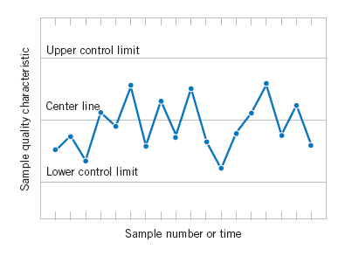
Introduction to Control Charts
Basic Principles
A typical control chart has control limits set at values such that if the process is in control, nearly all points will lie within the upper control limit (UCL) and the lower control limit (LCL).
A typical control chart.

Slide 7
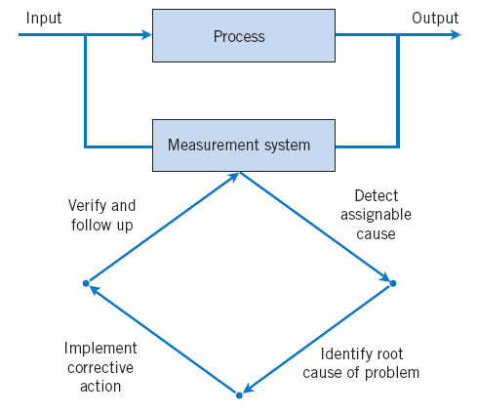
Introduction to Control Charts
Basic Principles
Figure Process improvement using the control chart.

Slide 8
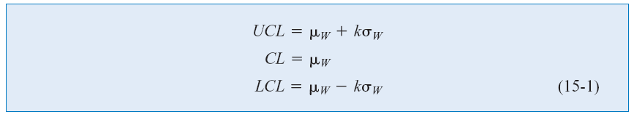
Introduction to Control Charts
Basic Principles
where
k = distance of the control limit from the center line
μ_{w} = mean of some sample statistic, W.
σ_{w} = standard deviation of some statistic, W.

Slide 9
Introduction to Control Charts
Basic Principles
Important uses of the control chart
Most processes do not operate in a state of statistical control
Consequently, the routine and attentive use of control charts will identify assignable causes. If these causes can be eliminated from the process, variability will be reduced and the process will be improved
The control chart only detects assignable causes. Management, operator, and engineering action will be necessary to eliminate the assignable causes.

Slide 10
Introduction to Control Charts
Basic Principles
Types of control charts
Variables Control Charts
  These charts are applied to data that follow a continuous distribution.
Attributes Control Charts
  These charts are applied to data that follow a discrete distribution.

Slide 11
Introduction to Control Charts
Basic Principles
Popularity of control charts
1) Control charts are a proven technique for improving productivity.
2) Control charts are effective in defect prevention.
3) Control charts prevent unnecessary process adjustment.
4) Control charts provide diagnostic information.
5) Control charts provide information about process capability.

Slide 12
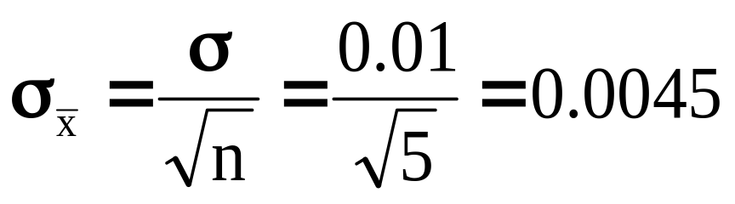
Introduction to Control Charts
Design of a Control Chart
Suppose we have a process that we assume the true process mean is μ = 74 and the process standard deviation is σ = 0.01. Samples of size 5 are taken giving a standard deviation of the sample average, is

Slide 13
Introduction to Control Charts
Design of a Control Chart
Control limits can be set at 3 standard deviations from the mean in both directions.
“3-Sigma Control Limits”
UCL = 74 + 3(0.0045) = 74.0135
CL= 74
LCL = 74 - 3(0.0045) = 73.9865

Slide 14
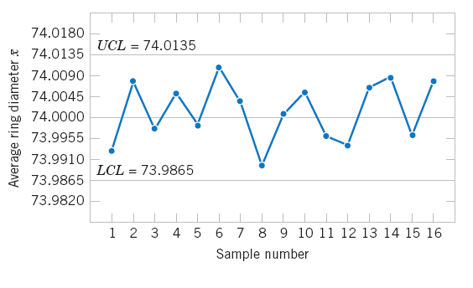
Introduction to Control Charts
2 Design of a Control Chart
Figure X-bar control chart for piston ring diameter.

Slide 15
Introduction to Control Charts
Rational Subgrouping
Subgroups or samples should be selected so that if assignable causes are present, the chance for differences between subgroups will be maximized, while the chance for differences due to these assignable causes within a subgroup will be minimized.

Slide 16
Introduction to Control Charts
Rational Subgrouping
Constructing Rational Subgroups
Select consecutive units of production.
  Provides a “snapshot” of the process.
  Good at detecting process shifts.
Select a random sample over the entire sampling interval.
  Good at detecting if a mean has shifted
  out-of-control and then back in-control.

Slide 17
Introduction to Control Charts
Analysis of Patterns on Control Charts
Look for “runs” - this is a sequence of observations of the same type (all above the center line, or all below the center line)
Runs of say 8 observations or more could indicate an out-of-control situation.
  Run up: a series of observations are increasing
  Run down: a series of observations are decreasing

Slide 18
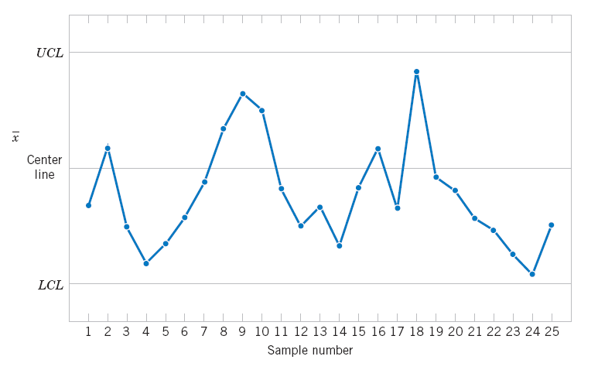
Introduction to Control Charts
Analysis of Patterns on Control Charts
Figure X-bar control chart.

Slide 19
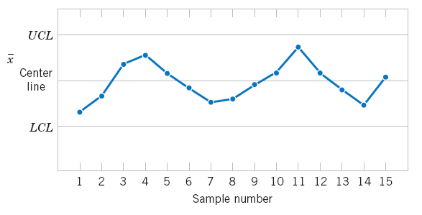
Introduction to Control Charts
Analysis of Patterns on Control Charts
Figure An X-bar chart with a cyclic pattern.

Slide 20
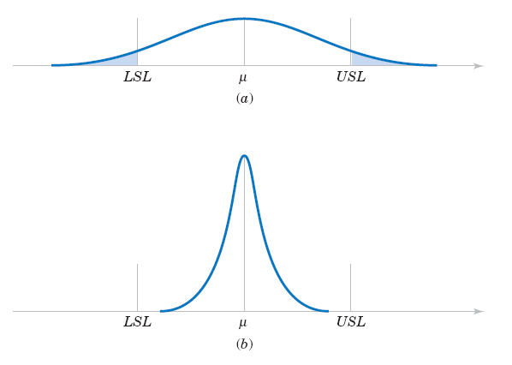
Introduction to Control Charts
Analysis of Patterns on Control Charts
Figure (a) Variability with the cyclic pattern. (b) Variability with the cyclic pattern eliminated.

Slide 21
Introduction to Control Charts
Analysis of Patterns on Control Charts
Western Electric Handbook Rules
A process is considered out of control if any of the
following occur:
1) One point plots outside the 3-sigma control limits.
2) Two out of three consecutive points plot beyond the 2-sigma warning limits.
3) Four out of five consecutive points plot at a distance of 1-sigma or beyond from the center line.
4) Eight consecutive points plot on one side of the center line.

Slide 22
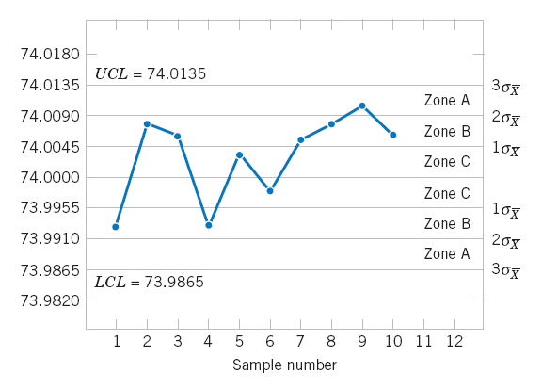
Introduction to Control Charts
Analysis of Patterns on Control Charts
Figure The Western Electric zone rules.

Slide 23
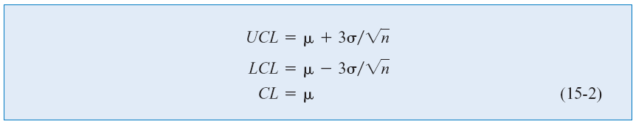


X-bar and R or S Control Charts
3-sigma control limits:
The grand mean:

Slide 24


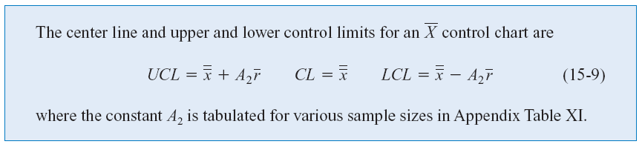
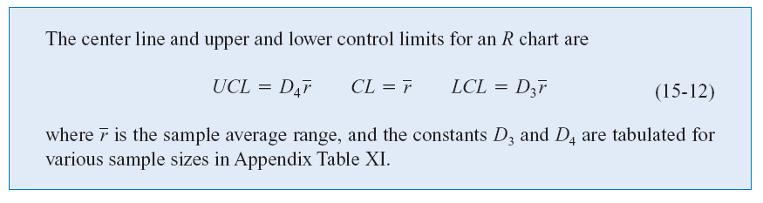
X-bar and R or S Control Charts
Control Chart (from ):
R Chart:

Slide 25
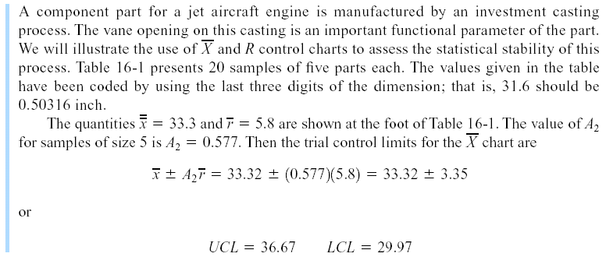
X-bar and R or S Control Charts
Example 15-1

Slide 26
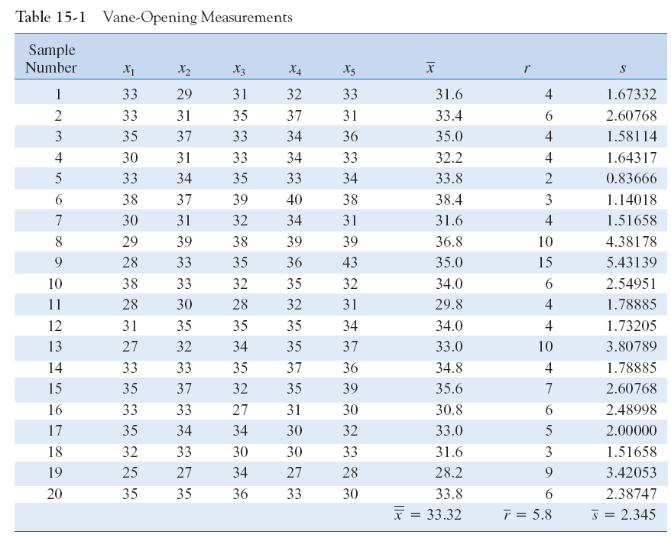

Slide 27
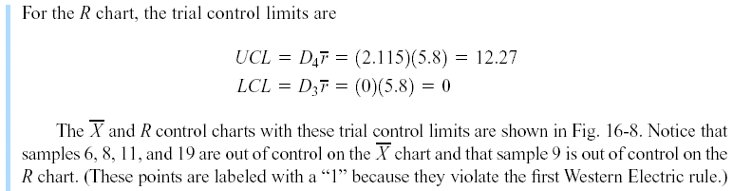
X-bar and R or S Control Charts
Example

Slide 28
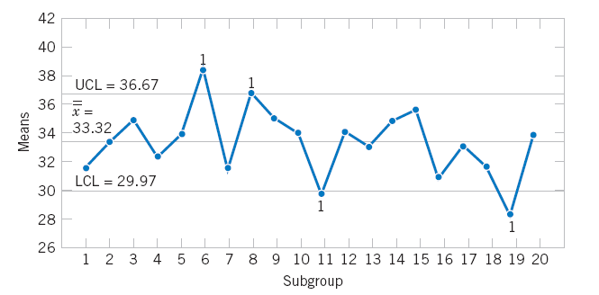

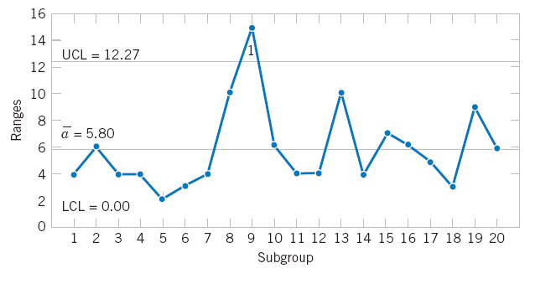
X-bar and R or S Control Charts
Example
Figure and R control charts for vane opening.

Slide 29
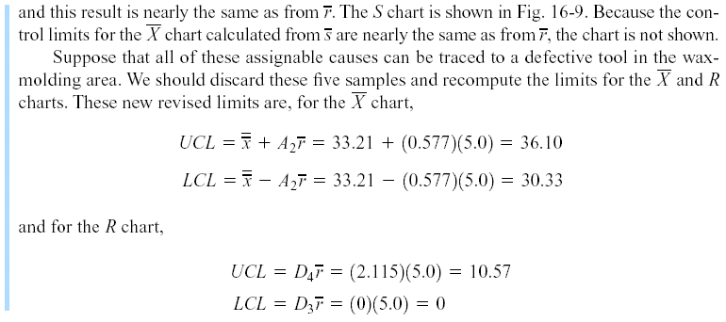
X-bar and R or S Control Charts
Example

Slide 30
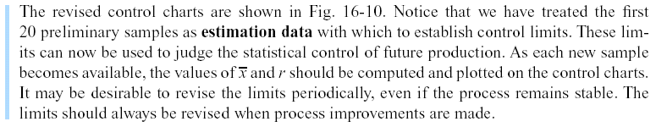
X-bar and R or S Control Charts
Example

Slide 31
15-4: Control Charts for Individual Measurements
What if you could not get a sample size greater than 1 (n =1)? Examples include
  Automated inspection and measurement technology is used, and every unit manufactured is analyzed.
  The production rate is very slow, and it is inconvenient to allow samples sizes of N > 1 to accumulate before analysis
  Repeat measurements on the process differ only because of laboratory or analysis error, as in many chemical processes.
The individual control charts are useful for samples of sizes n = 1.

Slide 32
15-5: Process Capability
Process capability refers to the performance of the process when it is operating in control.
Two graphical tools are helpful in assessing process capability:
  Tolerance chart (or tier chart)
  Histogram

Slide 33
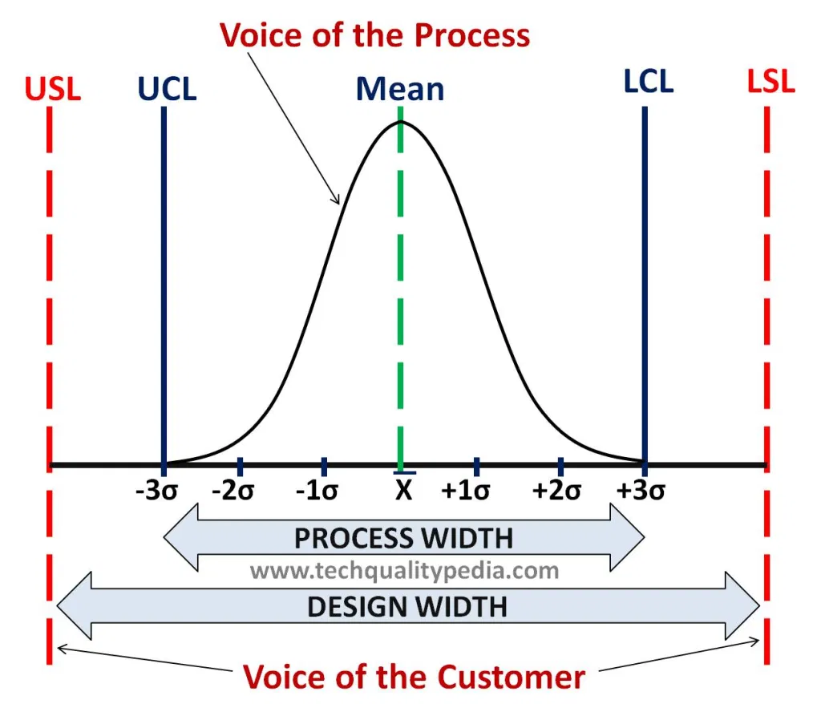
https://www.youtube.com/watch?v=ouMnoLcK6uw

Slide 34
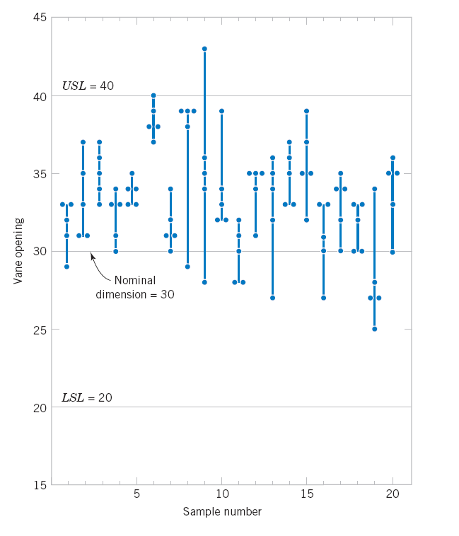
15-5: Process Capability
Tolerance Chart
Figure 16-12 Tolerance diagram of vane openings.

Slide 35
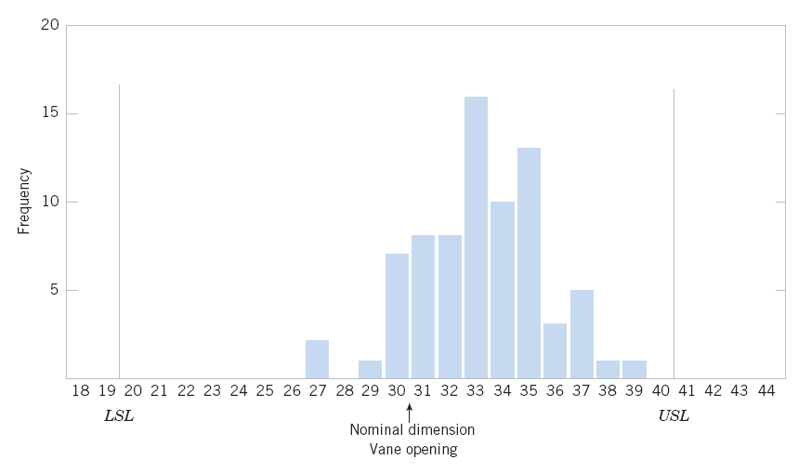
15-5: Process Capability
Histogram
Figure 15-13 Histogram for vane openings.

Slide 36
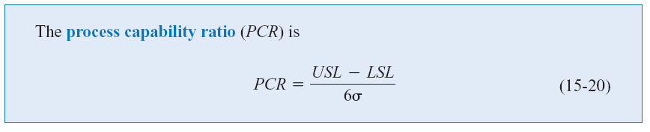
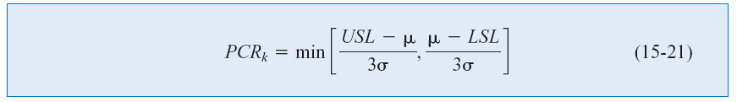
15-5: Process Capability
Process Capability Ratio
PCR_{k}

Slide 37
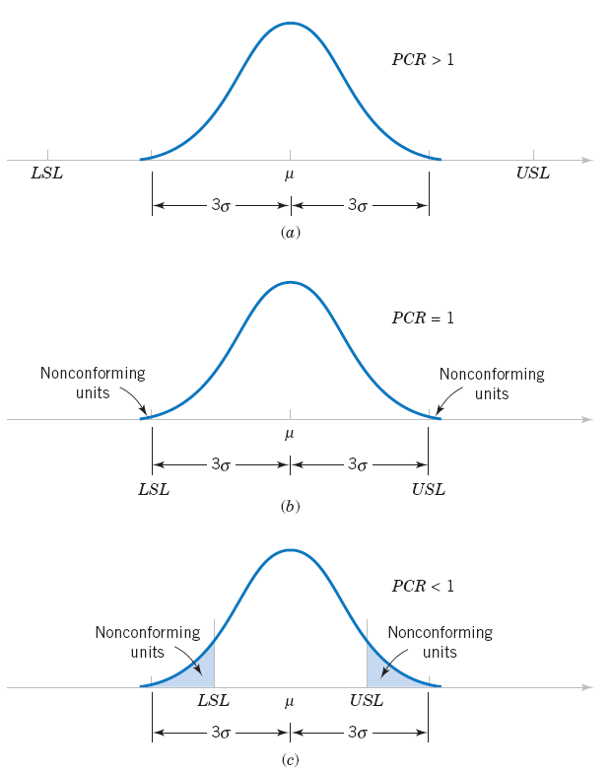
15-5: Process Capability
Figure 15-14 Process Fallout and the process capability ratio (PCR).

Slide 38
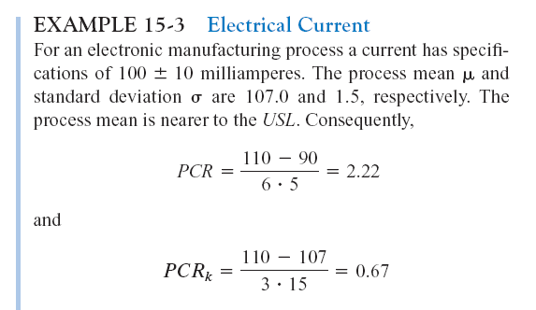

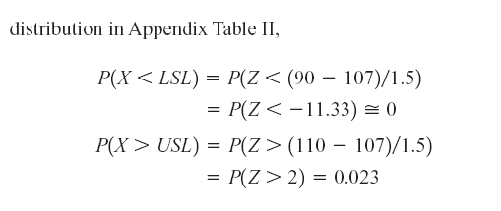
15-5: Process Capability
Example 15-3

Slide 39
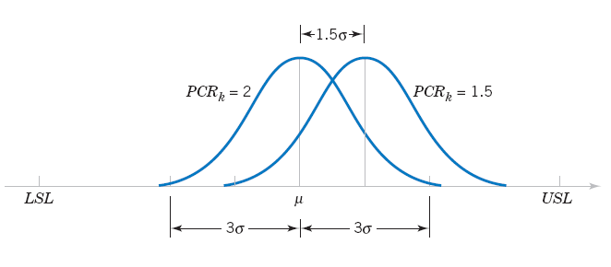
15-5: Process Capability
Figure 15-15 Mean of a six-sigma process shifts by 1.5 standard deviations.

Slide 40
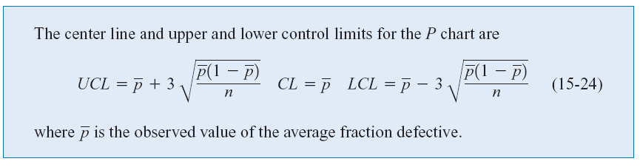
15-6: Attribute Control Charts
15-6.1 P Chart (Control Chart for Proportions)

Slide 41
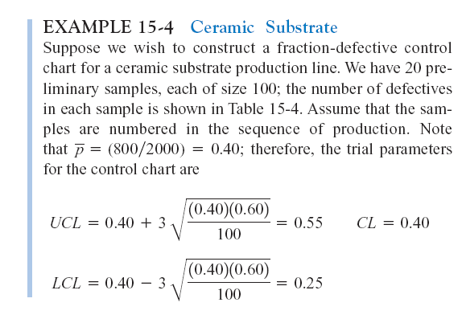
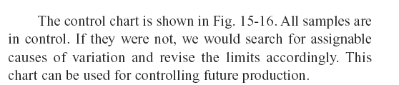
15-6: Attribute Control Charts
Example 15-4

Slide 42
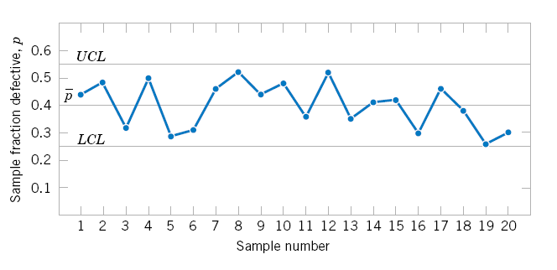
15-6: Attribute Control Charts
Example 15-4
Figure 15-16 P chart for a ceramic substrate.

Slide 43
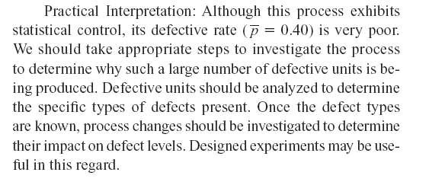
15-6: Attribute Control Charts
Example 15-4

Slide 44
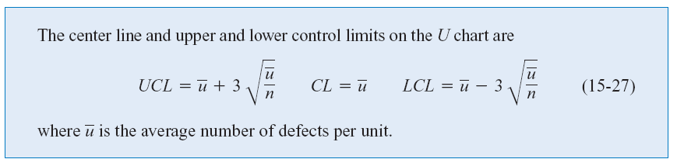
15-6: Attribute Control Charts
15-6.2 U Chart (Control Chart for Defects per Unit)

Slide 45
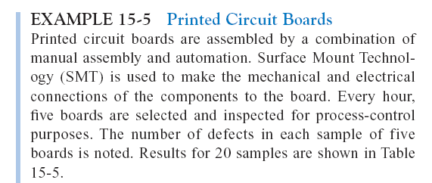
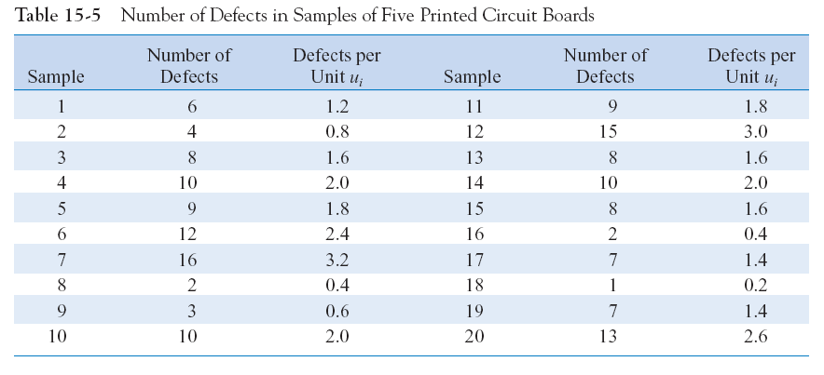
15-6: Attribute Control Charts
Example 15-5

Slide 46
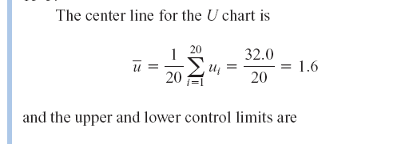
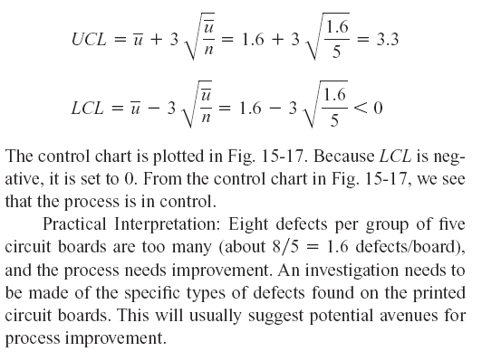
15-6: Attribute Control Charts
Example 15-5

Slide 47
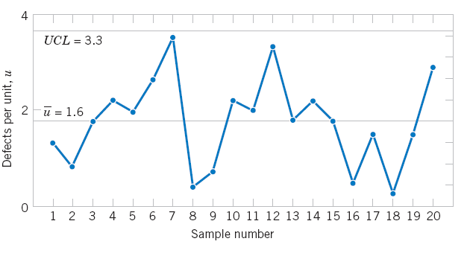
15-6: Attribute Control Charts
Example 15-5
Figure 15-17 U chart of defects per unit on printed circuit boards.

Slide 48
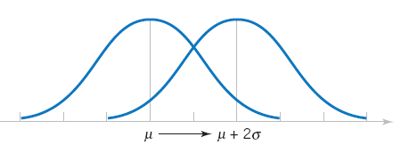
15-7: Control Chart Performance
Figure 15-18 Process mean shift of 2σ.

